Slide 1



Tom Andriola
Vice Chancellor for Information, Technology & Data
Chief Information Officer, UC Health
What Digital Transformation Means to Healthcare

Slide 2


Slide 3
Technology
Innovation & Disruption
Value Based Care Models
Provider Challenges
Revenues
Cost Structure
Care Quality
Patient Mix / Access
Consumerization
Patient Relationship
Scientific Advancement
Consumerization
3

Slide 4
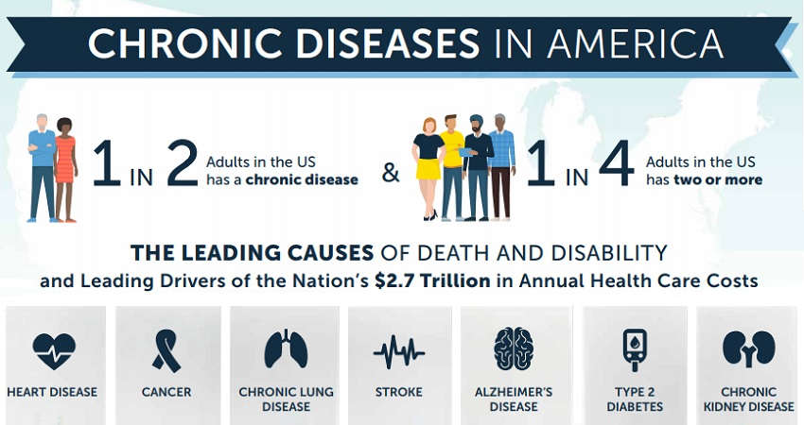

Slide 5


Slide 6
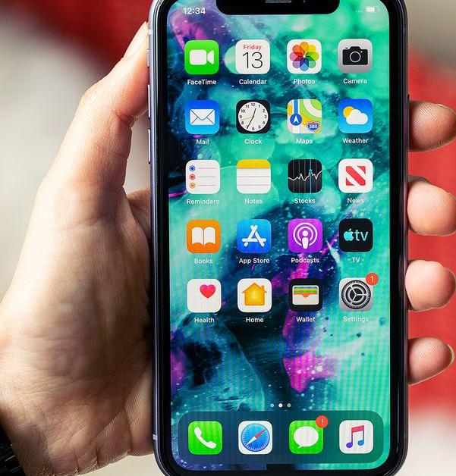

Broad trends
Data
Technology

Slide 7

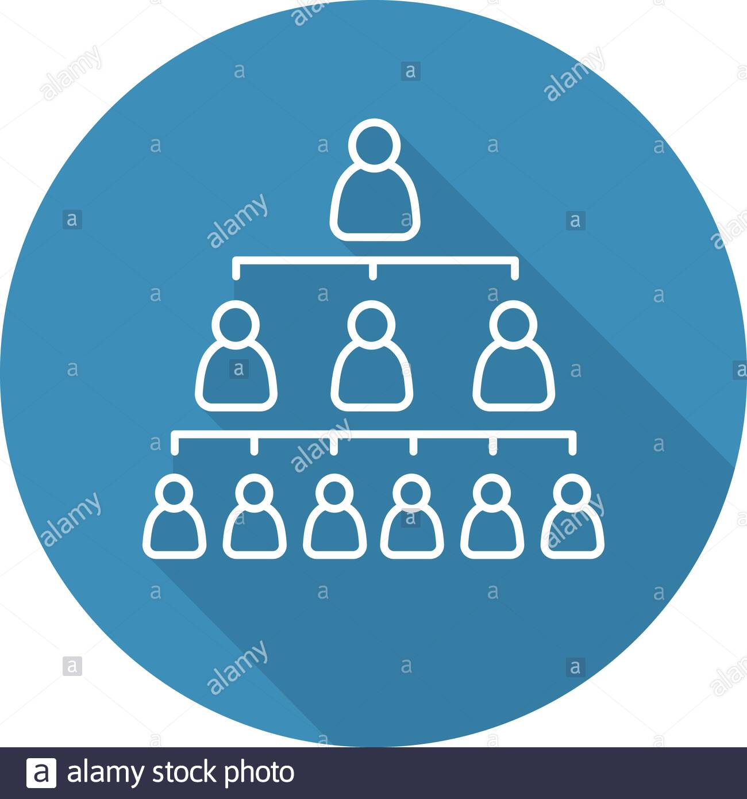
Recurring challenge
Data
Technology

Slide 8

BIG QUESTION - Who will figure it out first?
Will tech figure out healthcare? or
Will healthcare figure out tech?

Slide 9
Source: Visual Capitalist

Slide 11
Source: Nicholas Felton, The New York Times via HBR

Slide 12
Source: CB Insights

Slide 13


Slide 14
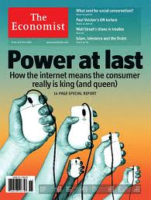

Slide 15


Federal Priorities
Reduce “Fraud, Abuse and Waste”
Impacts across agencies including FCC, CMS, HRSA
Reduce drug costs – 340B
Reduce redundancies of care (care coordination)
Increase Transparency in Health Care Costs
Give patient access to their own medical records
Open Health record systems to “big data” for analytics
ONC Information Blocking Rule
CMS Interoperability Rule
(Providers over Paperwork)
Trusted Exchange Framework and Common Agreement (TEFCA)

Slide 16
The Changing Competitive Landscape

Slide 17
The Changing Competitive Landscape

Slide 18
The Changing Competitive Landscape

Slide 19
The Changing Competitive Landscape

Slide 20

Big Tech
Federal Regulations
Investor Community
Consumerization

Slide 21
The consumerization of healthcare will continue to accelerate – there is no road back and leading organizations are already preparing

Slide 22
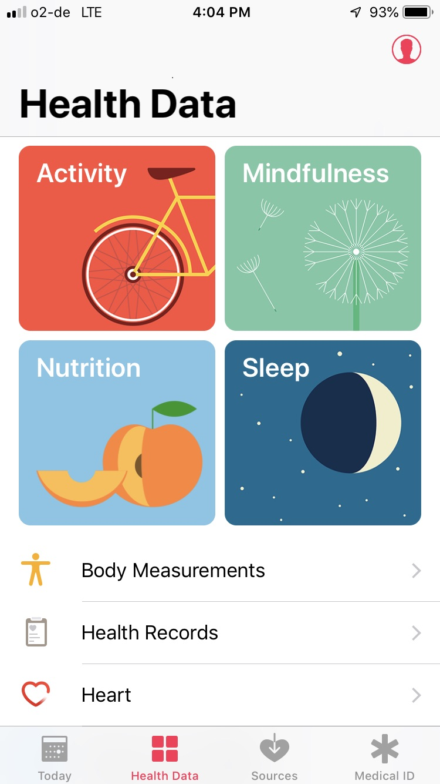
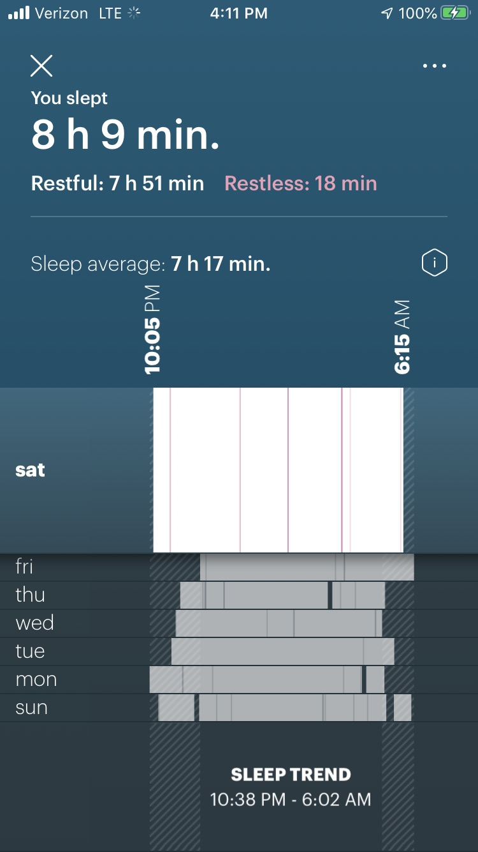

Slide 24
If “software is eating the world,” then what is it having for the next course?
(1) Marc Andreessen, co-founder & general partner of VC firm Andreessen Horowitz, published in The Wall Street Journal in 2011

Slide 25
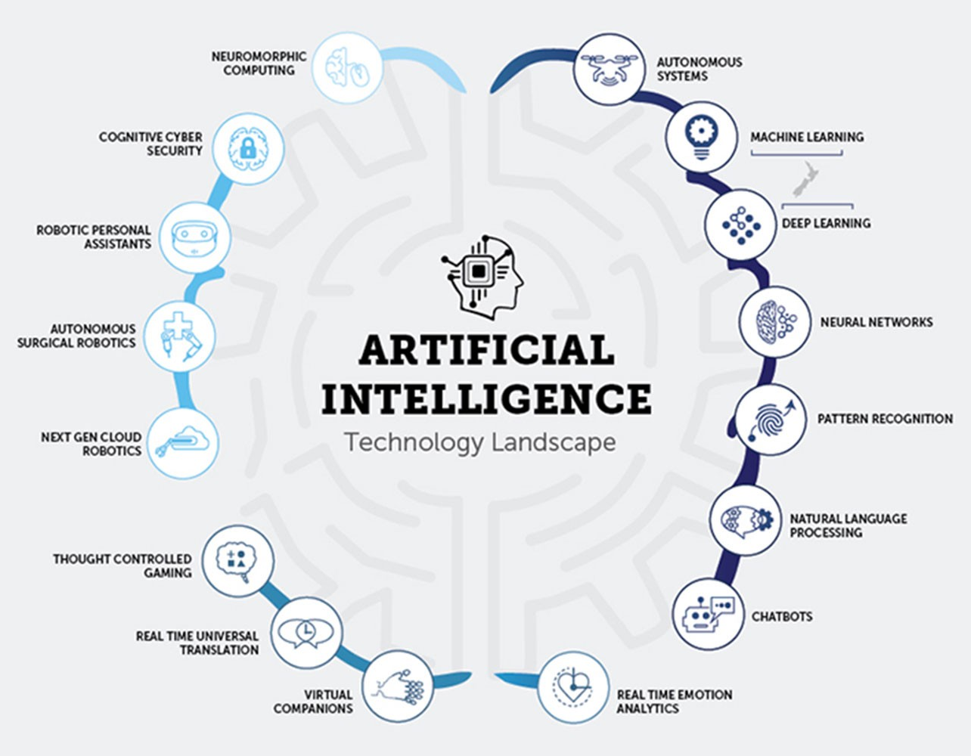
Q: Will algorithms become more important to the drug discovery process as petri dishes ?
Assist
Augment
Autonomous

Slide 27
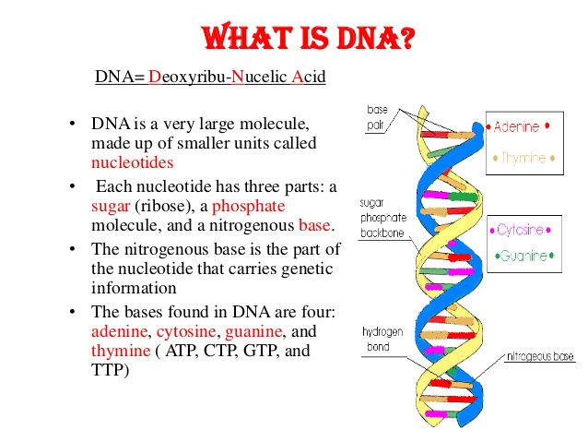

Slide 28
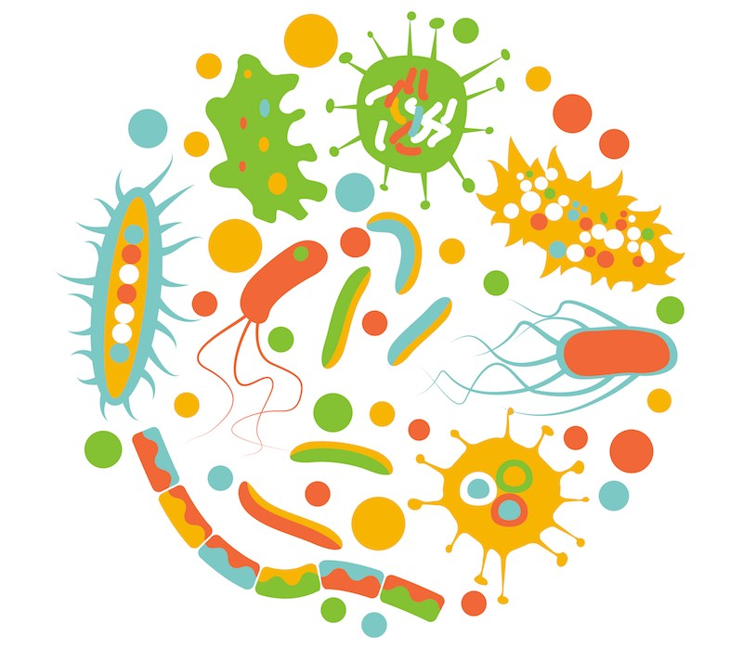
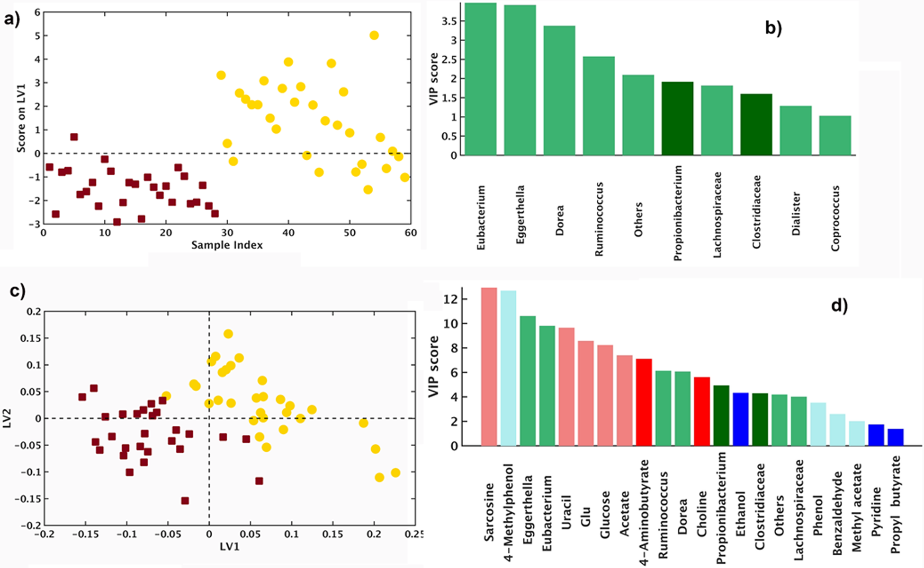
Understanding of the gut microbiome in the next 20 years will be equivalent to what we’ve learned from the sequencing of the human genome in the last 20 years
Gastro-intestinal
Endocrine
Cardiovascular
Neurological
Cancer

Slide 29
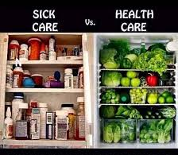

Slide 30
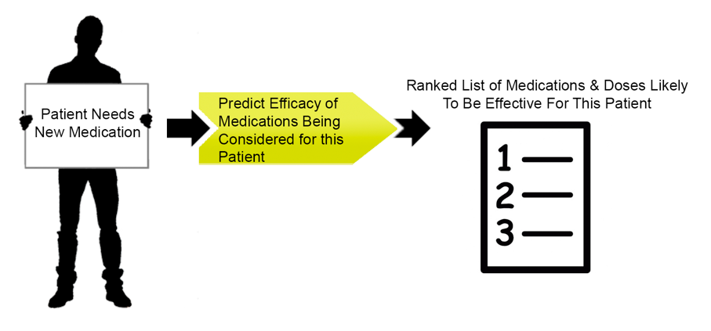


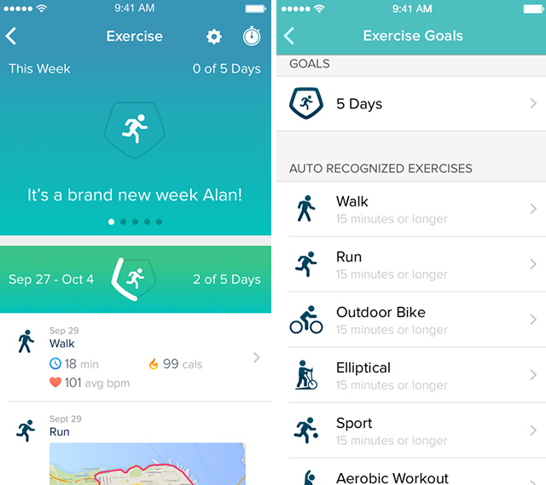
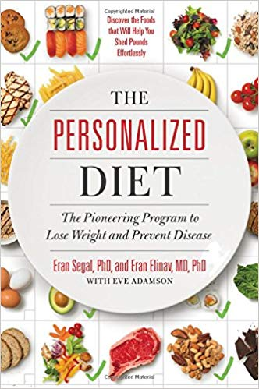
Consumer wants to be healthy

Slide 31
Digital Therapeutic development in anti-aging

Slide 32






Slide 33
Source: Visual Capitalist

Slide 34

Customer Obsession
Frictionless
2-pizza culture

Slide 37
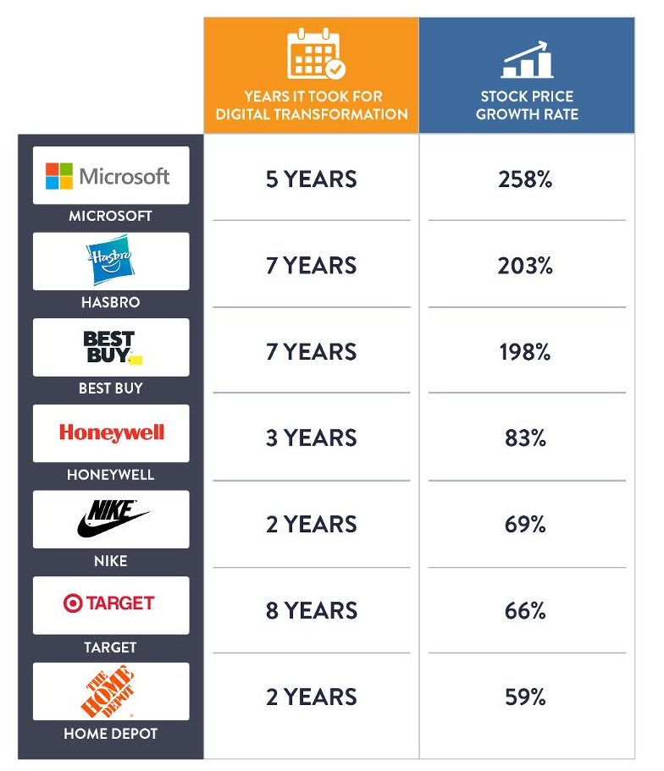
Digital Transformation is a committed journey
But many on the other side are reaping benefits

Slide 38
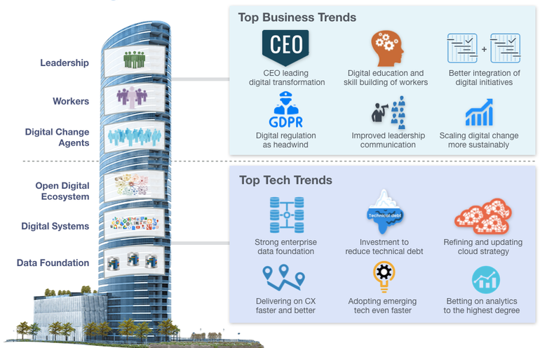

Slide 39
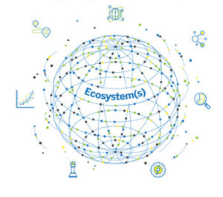

Slide 40
Data
Technology

Slide 41
Thank you for the time & the opportunity

